Slide 1
C++ Programming Design
Session #9

Slide 2
#9 Adventures in Classes
Using dynamic memory allocation for class members
Implicit and explicit copy constructors
Implicit and explicit overloaded assignment operators
Details when you use new in a constructor
Other class initialization ways
Observations about returning objects

Slide 3
A Bad Example
class StringBad
{
private:
char * str; // pointer to string
int len; // length of string
static int num_strings; // number of objects
public:
StringBad(const char * s); // constructor
StringBad(); // default constructor
~StringBad(); // destructor
friend std::ostream & operator<<(std::ostream & os, const StringBad & st); // friend function
};

Slide 4
A Bad Example
StringBad::StringBad(const char * s)
{
len = std::strlen(s); // set size
str = new char[len + 1]; // allot storage
std::strcpy(str, s); // initialize pointer
num_strings++; // set object count
cout << num_strings << ": \"" << str << "\" object created\n";
}
str = s;
StringBad::~StringBad() // necessary destructor
{
cout << "\"" << str << "\" object deleted, ";
--num_strings; // required
cout << num_strings << " left\n";
delete [] str; // required
}

Slide 5
Special Member Functions
The problems with the StringBad class are from:
Special member functions defined automatically.
C++ automatically provides the following member functions, if you define one:
(1)A default constructor
(2)A default destructor
(3)An address operator, which returns this pointer of invoking object
(4)A copy constructor
(5)An assignment operator
Intruduce problems

Slide 6
Copy Constructors
A copy constructor is used to copy an object to a newly created object.
The prototype of a copy constructor for a class:
Class_name(const Class_name &);
For example, a copy constructor for the StringBad class:
StringBad(const StringBad &);

Slide 7
Copy Constructors: When used
A copy constructor is invoked whenever a new object is created and initialized by an existing object of the same kind.
(1) When you explicitly initialize a new object by an existing object.
StringBad motto; //an existing object
StringBad ditto(motto);
StringBad metoo = motto;
StringBad also = StringBad(motto);
StringBad * pStringBad = new StringBad(motto);

Slide 8
Copy Constructors: When used
A copy constructor is invoked whenever a new object is created and initialized by an existing object of the same kind.
(2) When a function passes an object by value or when a function returns an object.
NOTE:
The fact that passing an object by value involves invoking a copy constructor is a good reason for passing by reference instead.

Slide 9
Copy Constructors: When used
A copy constructor is invoked whenever a new object is created and initialized by an existing object of the same kind.
(3) When the compiler generates temporary objects.
For example:
When adding three StringBad objects, a compiler might generate a temporary StringBad object to hold an intermediate result.

Slide 10
Copy Constructors: What to do
The default copy constructor performs a member-by-member copy of the nonstatic members.
(1)Also called shallow copying sometimes.
(2)If a member is itself a class object, the copy constructor for that class is used to copy one member object to another.
(3)Static members are unaffected, because they belong to the class as a whole instead of to individual objects.

Slide 11
Copy Constructors
For example:
StringBad ditto = motto;
StringBad ditto;
ditto.str = motto.str;
ditto.len = motto.len;
Default copy constructor
NOTE: Static members: num_strings,
are unaffected.

Slide 12
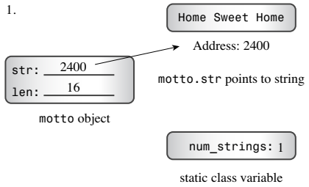
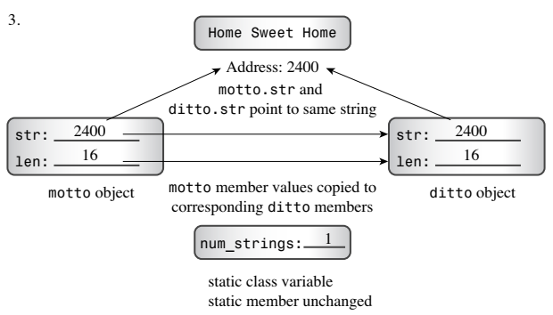
Copy Constructors: Problems
1
3
2
Problem 2
Problem 1

Slide 13
Copy Constructors: Solutions
Make a deep copying
(1)The copy constructor should modify static data member.
(2)The copy constructor should duplicate the string and assign the address of the new duplicate to the str member, rather than just copy the address of the string.

Slide 14
Copy Constructors: Solutions
StringBad::StringBad(const StringBad & st)
{
num_strings++; // handle static member update
len = st.len; // same length
str = new char [len + 1]; // allot space
std::strcpy(str, st.str); // copy string to new location
cout << num_strings << ": \"" << str << "\" object created\n";
}

Slide 15
Copy Constructors: Problems
1
3
2
Problem 2
Problem 1

Slide 16
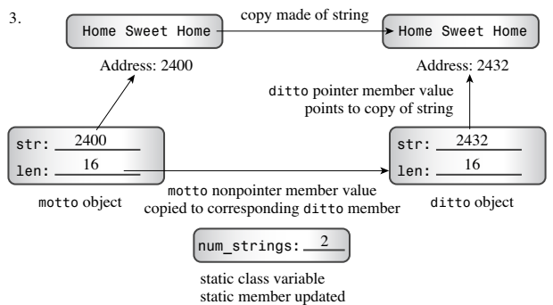
Copy Constructors: Solutions
1
3
2
Problem 2
Solving Problem 2
Problem 1
Solving Problem 1

Slide 17
Assignment Operators
C++ allows class object assignment, which automatically overloads an assignment operator for a class.
Assignment operator has the prototype:
Class_name & Class_name::operator=(const Class_name &);
For example, here’s the prototype for the StringBad class:
StringBad & StringBad::operator=(const StringBad &);

Slide 18
Assignment Operators: When used
(1)An overloaded assignment operator is used when you assign one object to another existing object:
For example:
StringBad headline1("Celery Stalks at Midnight");
StringBad knot;
knot = headline1; // assignment operator invoked

Slide 19
Assignment Operators: When used
(2)An assignment operator is not necessarily used when initializing an object:
For example:
StringBad knot;
StringBad metoo = knot;
// use copy constructor
//according to the compiler, possibly assignment, too

Slide 20
Assignment Operators: What to do
Like a copy constructor, an implicit implementation of an assignment operator performs a member-to-member copy.
(1)If a member is itself an object of some class, the program uses the assignment operator defined for that class to do the copying for that particular member.
(2)Static data members are unaffected.

Slide 21
Assignment Operators: Problems
For example:
knot = headline1;//StringBad class
The same problem occurs that the implicit copy constructor.

Slide 22
Assignment Operators: Solutions
Provide your own assignment operator definition, one that makes a deep copy.
(1)The implementation is similar to that of the copy constructor.
(2)But there are some differences, seeing the following example.

Slide 23
Assignment Operators: Comparison
StringBad::StringBad(const StringBad & st)
{
num_strings++;
len = st.len;
str = new char [len + 1];
std::strcpy(str, st.str);
}
1: Modify static data member
Copy constructor
StringBad & StringBad::operator=(const StringBad & st)
{
if (this == &st)
return *this;
delete [] str;
len = st.len;
str = new char [len + 1];
std::strcpy(str, st.str);
return *this;
}
4: Against on self assignment
Assignment
operator
overloading
2: Delete previously allocated data
3: Return reference to the invoking object.

Slide 24
Using new in constructors
You must take special care when using new to initialize pointer members of an object:
(1)If you use new to initialize a pointer member in a constructor, you should use delete in the destructor.
(2)The uses of new and delete should be compatible. You should pair new with delete and new [] with delete [].
(3)All constructors should use new the same way—either all with brackets or all without brackets.

Slide 25
Using new in constructors: GIVEN
String::~String() // necessary destructor
{
delete [] str; // required
}

Slide 26
Using new in constructors
String::String()
{
str = "default string";
len = std::strlen(str);
}
(1)
String::String(const char * s)
{
len = std::strlen(s);
str = new char;
std::strcpy(str, s);
}
(2)

Slide 27
Using new in constructors
String::String()
{
len = 0;
str = new char[1]; // uses new with []
str[0] = '\0';
}
(3)
String::String()
{
len = 0;
str = nullptr; // with C++11, or 0, null, NULL
}
(4)

Slide 28
Other class initialization ways
(1)Member initializer list
class Classx
{
private:
int x1;//Regular member
const int x2;//Const member
int & x3;//Reference member
}
Initialization in function body of constructor
Initialization before function body of constructor

Slide 29
Other class initialization ways
(1)Member initializer list in constructors
Classx::Classx(int m1, int m2, int &m3) : x2(m2), x3(m3)
{
x1=m1;
}
Member initializer list
Regular initialization

Slide 30
Other class initialization ways
(1)Member initializer list in constructors
Classx::Classx(int m1, int m2, int &m3) : x2(m2), x3(m3), x1(m1)
{
}
Member initializer list

Slide 31
Other class initialization ways
(2) C++11 member in-class initialization
class Classy
{
int mem1 = 10;
const int mem2 = 20;
}
Classy::Classy() : mem1(10), mem2(20) {...}

Slide 32
About Returning Objects
When a member function or standalone function returns an object, you have the following choices:
(1)Return a reference to an object
(2)Return a constant reference to an object
(3)Return an object
(4)Return a constant object

Slide 33
About Returning Objects
Return a reference or a object?
(1)Returning a reference is more efficient than a object
(2)Returning a reference only when referred thing is still available after the function ends
(3)Returning a object when it is a local object

Slide 34
About Returning Objects
Return const or non-const?
(1)Returning const if the returned thing is not as an lvalue.
(2)Returning non-const if the returned thing may be as an lvalue.

